Slide 1
Running a proper purple team
Travis Altman
RVAsec 14
June 2025
Slides:
https://travisaltman.com/purple/

Slide 2

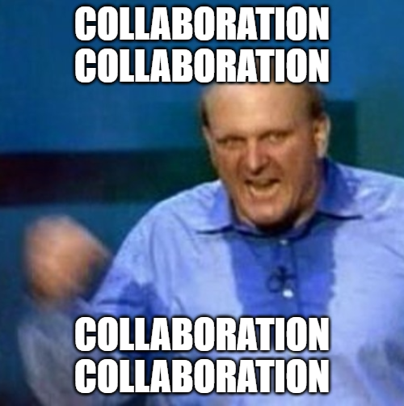
Purple teaming bluf
BLUF: Bottom Line Up Front
You should never "win" an argument

Slide 3
Purple teaming: overview
What
Silly it’s when Red and Blue (offense and defense) are combined
https://www.purestorage.com/uk/knowledge/purple-teaming.html
Why
Foster SOC collaboration
Validate security controls
Hone offensive tradecraft
Improve detection and response
Endgame is maturing your cybersecurity posture to defend against tip of the spear threat actors

Slide 4
Players, roles, and process
No matter the size of your team you’ll need to incorporate certain roles and responsibilities for successful purple teaming
Coordinator
Process of collaboration
Intel
Figures out what the bad guys are doing
Offense
Pretends to be the bad guy
Intel: Threat actor does this
Red: We can emulate
Response
Investigates the scope of bad guy activity
Detection
Builds alerting for bad guy activity
Blue: Got rules for that

Slide 5
Purple teaming: team size
Larger (+/- 50 FTE)
Pros
Throughput
Commercial tooling
Dedicated roles
Cons
Prioritization
Stakeholder communication
Deliverable messaging
Smaller (+/- 5 FTE)
Pros
Guerilla warfare
Simplification of prioritization
Concise reporting
Cons
Throughput
Open-source tooling
Roles with multiple hats

Slide 6
Simulation vs emulation
Think of it as a spectrum. Not a 1:1 but the further right you go the more mature your service should become
Automation
Manual
Simulation
Emulation
- Blue team validation scripts
- Specific threat actor procedure
- Red team concepts or scenarios
- Category of threat actor attacks

Slide 7
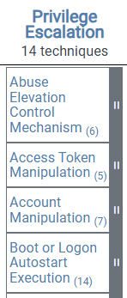
Simulation vs emulation
Examples
Tactic: Privilege Escalation
Plenty of resources
Rough set of controls
Open ended
Time boxed
Specific controls
Limited resources
Emulate
Technique: Process Injection
Procedure: Use Tool X inject into process Y
Simulate
https://attack.mitre.org/

Slide 8
Announced vs unannounced
Announced
Overt in nature
Like Penetration Testing
Focused more on technology
Responders play a limited role
Output focused on improving detection or prevention
Unannounced
Covert in nature
Like Red Teaming
Inclusive of People and Process not just Technology
Responders are highly engaged
Output focused on improving process

Slide 9
Unannounced: Industry posture
Attack IQ
Splunk
“Test people, processes, and tech”
“The blue team, comprising the organization's defenses, actively monitor and defend against these simulated attacks”
CrowdStrike
Scythe
"Raise healthy competition among security personnel and foster cooperation"
“Allows to test policies and processes in a controlled environment, helping identify weaknesses and areas for improvement”

Slide 10
Purple vs red vs pentesting
 | Purple | Red | Pentesting
Objective | Red-Blue collaboration | Improve security posture and readiness | Identify weakness
Approach | Integrate red team tactics juxtapose to blue team defenses | Zero knowledge full kill chain | Launch attacks based on full knowledge
Methodology | Scenarios | Objectives | Checklists
Scope | Pre-defined TTPs | Entire organization | Specific systems
Maturity Scale
Vuln Assessment
Pentesting
Purple Team
Red Team
Early adoption of Adversary Emulation might want to start on the left

Slide 11
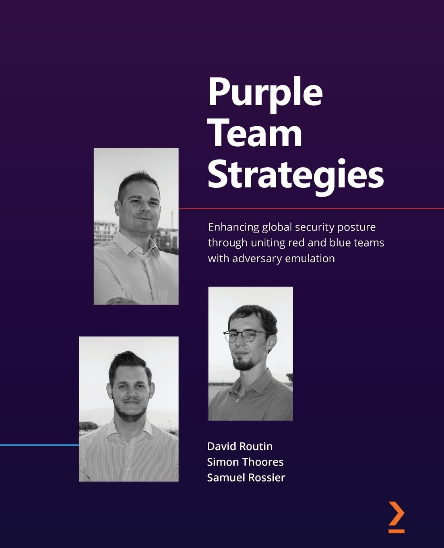
Purple team template
No “one true way” of executing and reporting
Some main things to consider
  Key takeaways
  Objective of the assessment
  Blue hypothesis (optional)
  Attack plan
  Rules table and outcome
  Activity log (blue and red notes)
Book has some templates

Slide 12
Template example
Item | Details
Key Message | Can’t prevent in our current environment but we can now detect malicious activity
Objective | Determine the effect that various malicious USB devices might have in our environment
Blue hypothesis | We currently have rules 1, 2, and 3 that should catch the usage of malicious USB
Attack plan | Various attacks Plug in standard USB (keyboard, mice, etc.) Plug in custom USB via Raspberry Pi Plug in commercial keystroke injector tool
Rules outcomes | Validated 3 rules, enhanced 1 rule, created 1 new rule
Activity log | -Red: Executed injector tool X at 3:31 PM EST on 3/4 -Blue: No telemetry found to view injector attack

Slide 13
Purple team metrics
Announced
Number of assessments
Number of rules tested
Number of rules validated
Number of rules enhanced
Number of rules created
Unannounced
Time to detect
Time to respond
Time to contain
How would you define detect, respond, or contain?

Slide 14




Metric guidelines
Term | Definition | Example
Alert | Suspicious activity | Security rule fires
Detect | Verifying a threat | Incident ticket is cut
Respond | Root cause + impact | Malware analysis + severity
Contain | Threat removed | Clean endpoint and incident closed
Threat confirmed
Close incident
Rule fires
Investigation

Slide 15






Challenging environments
Apple
Linux
Cloud
Windows endpoint should be top priority
As the service matures begin to look in other areas beyond endpoint
Ensure telemetry and logging have been implemented in those areas
Servers
IoT
Mobile

Slide 16




takeaways
If I had to start all over again, what would I focus on
Nobody’s perfect experiment and iterate
Culture of collaboration
Highlight wins and people
No side wins, focus on improvement

Slide 17

Thank you
Travis Altman
https://travisaltman.com
https://www.linkedin.com/in/travisaltman/

